Slide 1
Repository and
Unit of Work
Design Patterns
with ASP.NET MVC and EF

Slide 2
Agenda
Repository pattern
Unit of Work
Implementation with EF5 and ASP.Net MVC
Entity Framework 6 and ASP.NET MVC 5
Summary

Slide 3
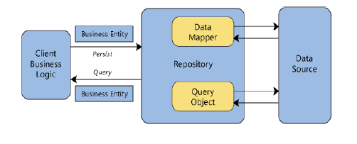
Repository Pattern
Mediator between BLL and DAL(Data Source)
It’s a separation layer between Data and Domain Layer

Slide 4
What about DAOs ?
• A Data Access Object doesn’t hide to the Data Access Layer that it is accessing a data table, unlike a Repository.
• A DAO typically has a 1:1 map with a data store table or entity-set.
• A Repository acts at a higher level of abstraction working with aggregations of business entities.

Slide 5
Why use Repositories ?
Abstraction layer between Business Logic Layer and Data Access Layer.
Insulates application (Controller) from data store changes.
Facilitates automated Unit Testing, Test Driven Development.
Data Source can be changed without any changes in Business Logic Layer and minimum changes in Repository.
Easy to create mock repositories using in-memory domain object collections as a data store. But it’s difficult to mock entities similarly.

Slide 6
IGenericRepository<TEntity>
public interface IGenericRepository<TEntity> where TEntity : class
{
IEnumerable<TEntity> Get( Expression<Func<TEntity, bool>> filter = null, Func<IQueryable<TEntity>, IOrderedQueryable<TEntity>> orderBy = null, string includeProperties = "");
TEntity GetByID(object id);
void Insert(TEntity entity);
void Delete(object id);
void Delete(TEntity entityToDelete);
void Update(TEntity entityToUpdate);
}

Slide 7
GenericRepository<TEntity> constructor
public class GenericRepository<TEntity> : IGenericRepository<Tentity> where TEntity : class
{
internal SchoolContext context;
internal DbSet<TEntity> dbSet;
public GenericRepository(SchoolContext context)
{
this.context = context;
this.dbSet = context.Set<TEntity>();
}

Slide 8
IEnumerable<TEnitity> Get(…)
public virtual IEnumerable<TEntity> Get( Expression<Func<TEntity, bool>> filter = null, Func<IQueryable<TEntity>, IOrderedQueryable<TEntity>> orderBy = null,
string includeProperties = "")
{
IQueryable<TEntity> query = dbSet;
if (filter != null)
{
query = query.Where(filter);
}
foreach (var includeProperty in includeProperties.Split
(new char[] { ',' }, StringSplitOptions.RemoveEmptyEntries))
{
query = query.Include(includeProperty);
}
if (orderBy != null)
{
return orderBy(query).ToList();
}
else
{
return query.ToList();
}
}

Slide 9
Remaining CRUD method implementations
public virtual TEntity GetByID(object id)
{
return dbSet.Find(id);
}
public virtual void Insert(TEntity entity)
{
dbSet.Add(entity);
}
public virtual void Delete(object id)
{
TEntity entityToDelete = dbSet.Find(id);
Delete(entityToDelete);
}
public virtual void Delete(TEntity entityToDelete)
{
if (context.Entry(entityToDelete).State == EntityState.Detached)
{
dbSet.Attach(entityToDelete);
}
dbSet.Remove(entityToDelete);
}
public virtual void Update(TEntity entityToUpdate)
{
dbSet.Attach(entityToUpdate);
context.Entry(entityToUpdate).State = EntityState.Modified;
}

Slide 10
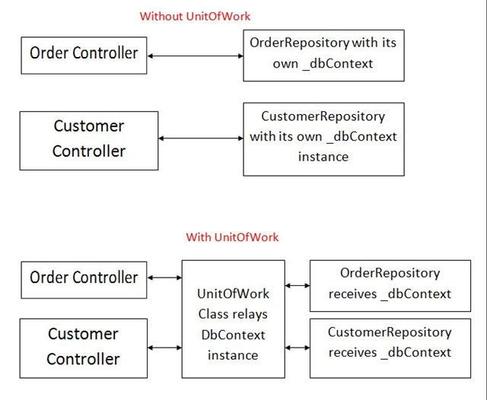
Unit of Work (UoW)
Object-Relational Behavior Patterns
• Unit of Work
• Identity Map
• Lazy Load
UoW – Maintains a list of objects affected by a business transaction and coordinates the writing out of changes and the resolution of concurrency problems

Slide 11
Why use UoW ?
Keeps track of manipulated objects in order to synchronize in-memory data with the data store.
Provides a single transaction for multiple queries.
The UoW commits the transaction.
If the commit fails, rollback.
Single commit call on the database.
All object tracking information is centralized.
Provides a firm means for complex scenarios like handling business transactions that span several system transactions using Optimistic Offline Lock and Pessimistic Offline Lock.

Slide 12
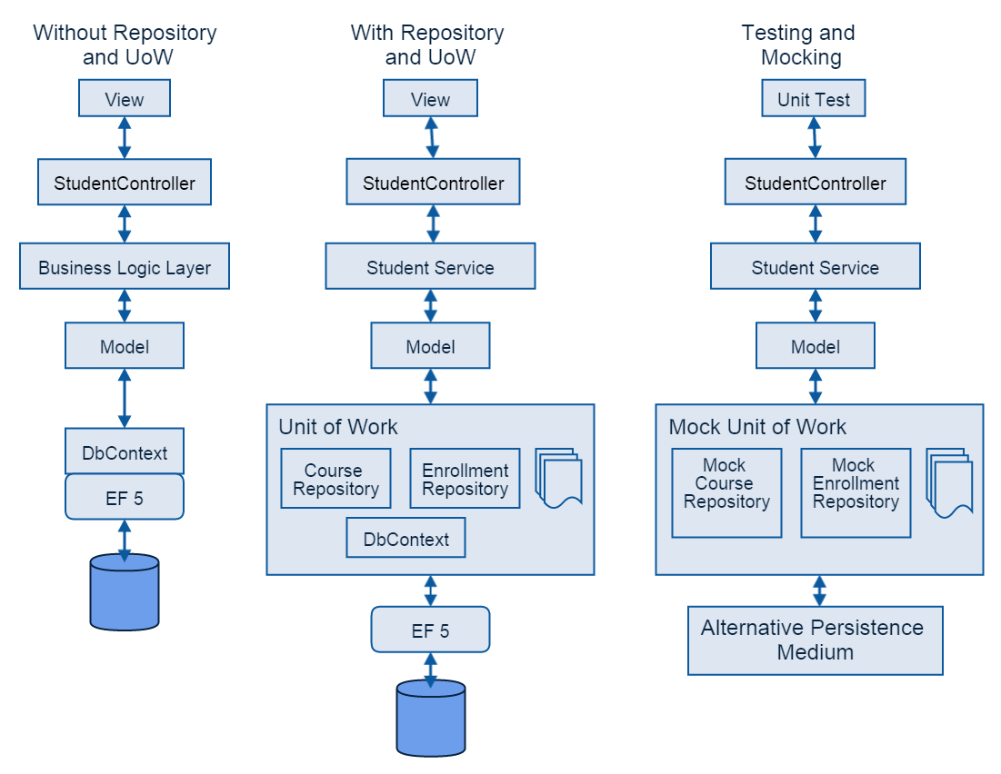
Entity Framework 5 and MVC 4
(and previous versions)…

Slide 13
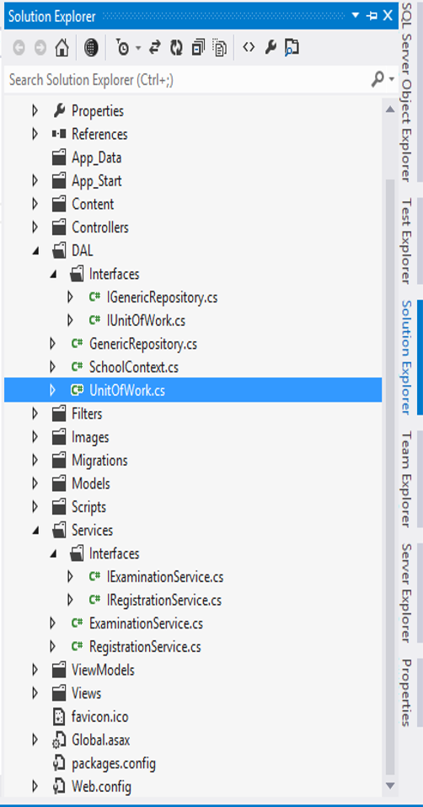
A possible project structure

Slide 14
IUnitOfWork interface
public interface IUnitOfWork
{
GenericRepository<Department> DepartmentRepository {get;}
GenericRepository<Course> CourseRepository {get;}
GenericRepository<Person> PersonRepository{get;}
GenericRepository<Student> StudentRepository{get;}
GenericRepository<Instructor> InstructorRepository{get;}
}

Slide 15
UnitofWork.cs
public class UnitOfWork : IUnitOfWork, IDisposable
{
private SchoolContext context = new SchoolContext();
private GenericRepository<Department> departmentRepository;
private GenericRepository<Course> courseRepository;
private GenericRepository<Person> personRepository;
private GenericRepository<Student> studentRepository;
private GenericRepository<Instructor> instructorRepository;
//Generic repository instantiation for every entity-set in domain
// using a single shared DbContext object within a UoW wrapper
//…
}

Slide 16
GenericRepository<TEntity> Getters
public GenericRepository<Department> DepartmentRepository
{
get
{
if (this.departmentRepository == null)
{
this.departmentRepository = new GenericRepository<Department>(context);
}
return departmentRepository;
}
}
public GenericRepository<Course> CourseRepository
{
get
{
if (this.courseRepository == null)
{
this.courseRepository = new GenericRepository<Course>(context);
}
return courseRepository;
}
}

Slide 17
Persist DbContext changes and clean up resources
public void Save()
{
context.SaveChanges();
}
private bool disposed = false;
protected virtual void Dispose(bool disposing)
{
if (!this.disposed)
{
if (disposing)
{
context.Dispose();
}
}
this.disposed = true;
}
public void Dispose()
{
Dispose(true);
GC.SuppressFinalize(this);
}

Slide 18
EF DbContext implementer
public class SchoolContext : DbContext
{
public DbSet<Course> Courses {get;set;}
public DbSet<Department> Departments {get;set;}
public DbSet<Enrollment> Enrollments {get;set;}
public DbSet<Instructor> Instructors {get;set;}
public DbSet<Student> Students {get;set;}
protected override void OnModelCreating(DbModelBuilder modelBuilder)
{
//…
}
}

Slide 19
How does the architectural wiring come live in the controller ?
namespace ContosoUniversity.Controllers
{
public class CourseController : Controller
{
private UnitOfWork unitOfWork = new UnitOfWork();
//
// GET: /Course/
public ViewResult Index()
{
var courses = unitOfWork.CourseRepository.Get(includeProperties: "Department");
return View(courses.ToList());
}
//
// GET: /Course/Details/5
public ViewResult Details(int id)
{
Course course = unitOfWork.CourseRepository.GetByID(id);
return View(course);
}
//…
}
}

Slide 20
Sample Edit, Get(…) calls
[HttpPost] [ValidateAntiForgeryToken]
public ActionResult Edit( [Bind(Include = "CourseID,Title,Credits,DepartmentID")] Course course)
{
try
{
if (ModelState.IsValid)
{
unitOfWork.CourseRepository.Update(course);
unitOfWork.Save();
return RedirectToAction("Index");
}
}
catch (DataException dex)
{
ModelState.AddModelError("", "Unable to save changes. Try again, and if the problem persists, see your system administrator.");
}
PopulateDepartmentsDropDownList(course.DepartmentID);
return View(course);
}
private void PopulateDepartmentsDropDownList(object selectedDepartment = null)
{
var departmentsQuery = unitOfWork.DepartmentRepository.Get( orderBy: q => q.OrderBy(d => d.Name));
ViewBag.DepartmentID = new SelectList(departmentsQuery, "DepartmentID", "Name", selectedDepartment);
}

Slide 21
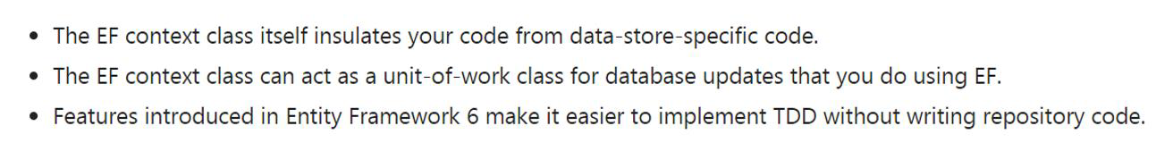
Entity Framework 6 and
ASP.NET MVC 5
From http://goo.gl/eyDbrM
Advanced Entity Framework 6 Scenarios for an MVC 5 Web Application (12 of 12) ASP.NET MVC Site

Slide 22
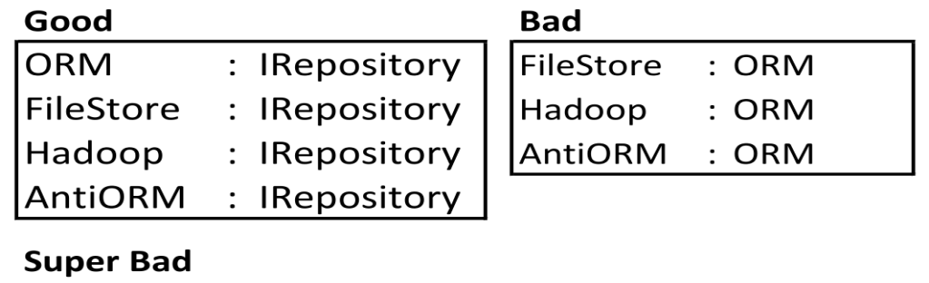
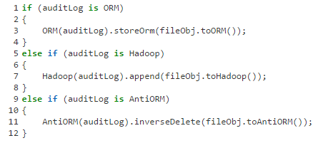
Consider following scenarios without repositories

Slide 23
Summary
• Business objects should interface with a business oriented storage service
• Data objects should interface with a data oriented service
• The repository should be the bridging mediator
• BUT the real use case for the Repository pattern is in dealing with multiple persistence services

Slide 24
References
http://www.asp.net/mvc/overview/older-versions/getting-started-with-ef-5-using-mvc-4/implementing-the-repository-and-unit-of-work-patterns-in-an-asp-net-mvc-application
http://www.asp.net/mvc/overview/getting-started/getting-started-with-ef-using-mvc/advanced-entity-framework-scenarios-for-an-mvc-web-application#repo

Slide 25
?

